Slide 1
Ordinary Differential
Equations:
Initial Value Problem
Course : MATH6183 – Scientific Computing
Year : 2021

Slide 2
Outlines
Initial Value Problems
Numerical Error and Instability
Euler Method
Runge-Kutta Methods

Slide 3

Introduction
An ordinary differential equation of order n
can always be transformed into n first-order equations. Using the notation
If these conditions are specified at the same value of x, the problem is said to be an initial value problem. Then the auxiliary conditions, called initial conditions, have the form
If y_{i} are specified at different values of x, the problem is called a boundary value problem.

Slide 4

Taylor Series Method
The Taylor series method is conceptually simple and capable of high accuracy. Its basis is the truncated Taylor series for y about x:
The last term kept in the series determines the order of integration.
The truncation error, due to the terms omitted from the series, is

Slide 5


Taylor Series Method
Using the finite difference approximation
we obtain the more usable form
which could be incorporated in the algorithm to monitor the error in each integration
step.

Slide 6




Example 1
Given that
determine y(0.1) with the fourth-order Taylor series method using a single integration step. Also compute the estimated error and compare it with the actual error. The analytical solution of the differential equation is
Solution
The Taylor series up to and including the term with h⁴ is
Differentiation of the differential equation yields

Slide 7

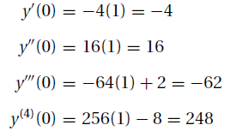

Example 1
Thus, at x = 0 we have
With h = 0.1, we get

Slide 8



Example 1
The approximate truncation error is
The analytical solution yields
so that the actual error is 0.670623 − 0.670700 = −7.7 × 10−5.

Slide 9
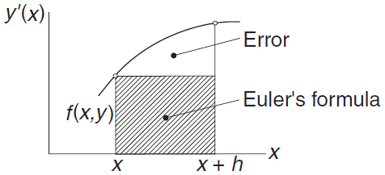

Runge-Kutta Methods
The aim of Runge–Kutta methods
is to eliminate the need for repeated
differentiation of the differential
equations. Because no such
differentiation is involved in the first-
order Taylor series integration formula
it can also be considered as the first-order Runge–Kutta method; it is also called Euler’s method.
The change in the solution y between x and x + h is

Slide 10
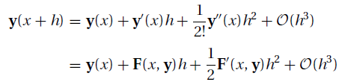


Second Order Runge-Kutta Methods
To arrive at the second-order method, we assume an integration formula of the form
(a)
and attempt to find the parameters c0, c1, p, and q by matching above equation to the Taylor series
(b)
Noting that :
where n is the number of first-order equations, Eq. (b) can be written as
(c)

Slide 11



Second Order Runge-Kutta Methods
Returning to Eq. (a), we can rewrite the last term by applying Taylor series in several variables, so that Eq. (a) becomes
(d)
Comparing Eqs. (c) and (d), we find that they are identical if
(e)
Because Eqs. (e) represent three equations in four unknown parameters, we can assign any value to one of the parameters. Some of the popular choices and the names associated with the resulting formulas are:

Slide 12

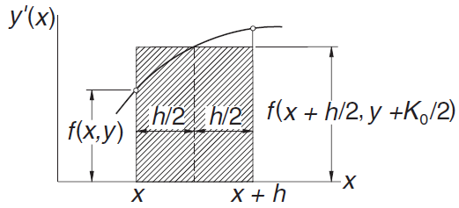
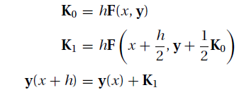
Second Order Runge-Kutta Methods
Choosing the modified Euler’s method, substitution of the corresponding parameters into Eq. (a) yields
This integration formula can be conveniently evaluated by the following sequence of operations:

Slide 13

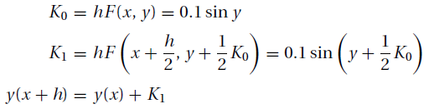
Example 2
Use the second-order Runge–Kutta method to integrate
from x = 0 to 0.5 in steps of h = 0.1. Keep four decimal places in the computations.
Solution
In this problem, we have F(x, y) = sin y so that the integration formulas are

Slide 14
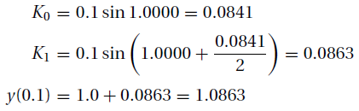
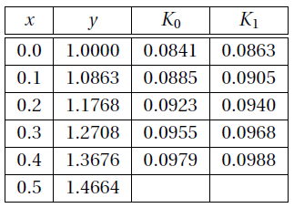
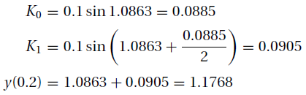
Example 2
We note that y(0) = 1; the integration then proceeds as follows:
and so on. A summary of the computations is shown in the table.
The exact solution can be shown to be
which yields x(1.4664) = 0.5000

Slide 15
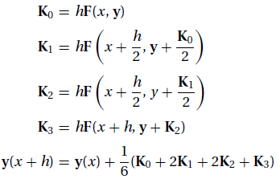
Fourth -Order Runge–Kutta Method
The fourth-order Runge–Kutta method is obtained from the Taylor series along the same lines as the second-order method. The final form of the integration formula again depends on the choice of the parameters, that is, there is no unique Runge–Kutta fourthorder formula. The most popular version, which is known simply as the Runge–Kutta method, entails the following sequence of operations:

Slide 16
Example 3
Consider
initial condition y(0) = 1 and Δh = 0,1
Solution

Slide 17
Exercise
Given
y’ + 4y = x² y(0) = 1
Compute y(0.1) using two steps of the Taylor series method of order 2.
Solve Prob. 1 with one step of the Runge–Kutta method of order (a) 2 and (b) 4.

Slide 18
Numerical Error and Instability
There are two main issues to consider with regard to integration schemes for ODEs: accuracy and stability.
Accuracy refers to a scheme’s ability to get close to the exact solution, which is usually unknown, as a function of the step size h. Previous chapters have referred to accuracy using the notation O(hp). The same notation can be used to solve ODEs.
The stability of an integration scheme is its ability to keep the error from growing as it integrates forward in time. If the error does not grow, then the scheme is stable; otherwise it is unstable. Some integration schemes are stable for certain choices of h and unstable for others; these integration schemes are also referred to as unstable
To illustrate issues of stability, we numerically solve the pendulum equation using the explicit and implicit Euler, as well as trapezoidal, formulas.

Slide 19
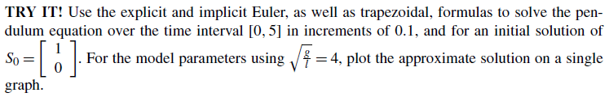
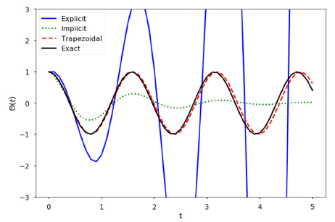
Numerical Error and Instability
Numerical Solution
The exact solution is a pure cosine wave
The explicit Euler scheme is clearly unstable.
The implicit Euler scheme decays exponentially, which is not correct.
The trapezoidal method captures the solution correctly, with a small phase shift as time increases.

Slide 20
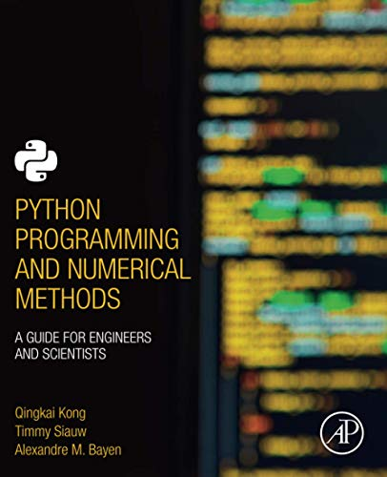
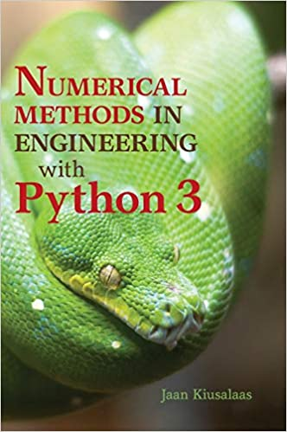
These slides have been adapted from: Kong, Q., Siauw, T., & Bayen, A. M. (2021). Python Programming and Numerical Methods: A Guide for Engineers and Scientists. Academic Press. ISBN: 978-0-12-819549-9 Kiusalaas, J. (2013). Numerical Methods in Engineering with Python 3. United Kingdom: Cambridge University Press. ISBN:9781107033856 additional materials Chapra, S.C (2015). Numerical Methods for Engineers. 6st Edition. McGraw-Hill Companies, Inc . New York. ISBN. 978-981-4670-87
Acknowledgement

